Slide 1
Hotel Reviews
Analysis reviews of hotels in Europe
(Netherlands,United Kingdom,France,Spain,Italy,Austrlia)

Slide 2
Hotel reviews are gold mine of customer insights for any hotel business. Also, its importance increases by many folds since majority of the future customers rely on the peer reviews while finalizing their stay.

Slide 3
In this study, we will analyze reviews of the best rated and least rated hotels located within Europe to compare different aspects of rating and review text and monitoring customer behavior.

Slide 4
Goals
Comparison of overall rating per Reviewer Nationality
Time Series analysis of review count
The best 3 hotels in each country
The worst 3 hotels in each country
What are the best destination and best hotels for Arab guests, and what were their reviews?
What about business trips, the average days of stay and the most reserved rooms, and do they have special requests during booking
What about the type of guests, whether single or couple
What is the ratio of tourists to non-tourists in the data?

Slide 5
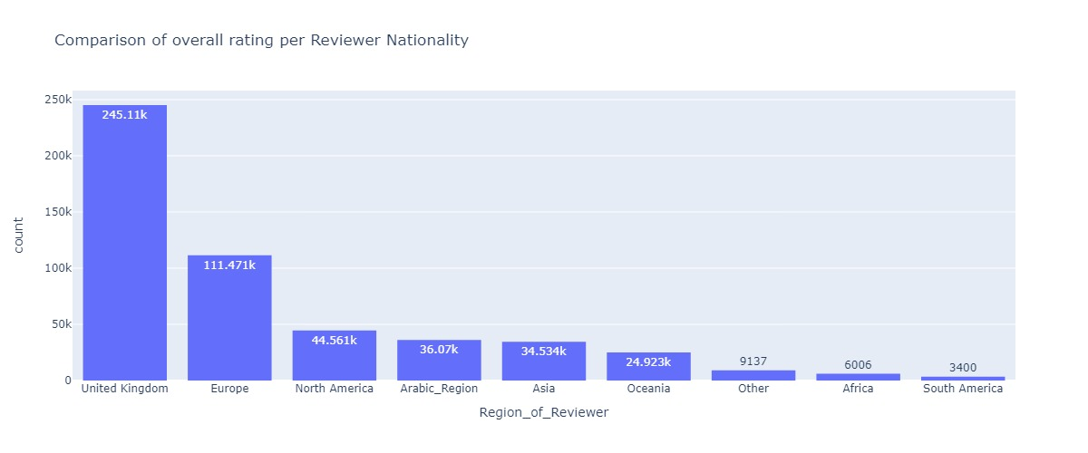
Comparison of overall rating per Reviewer Nationality: the chart shows the most rated nationalities for hotels

Slide 6
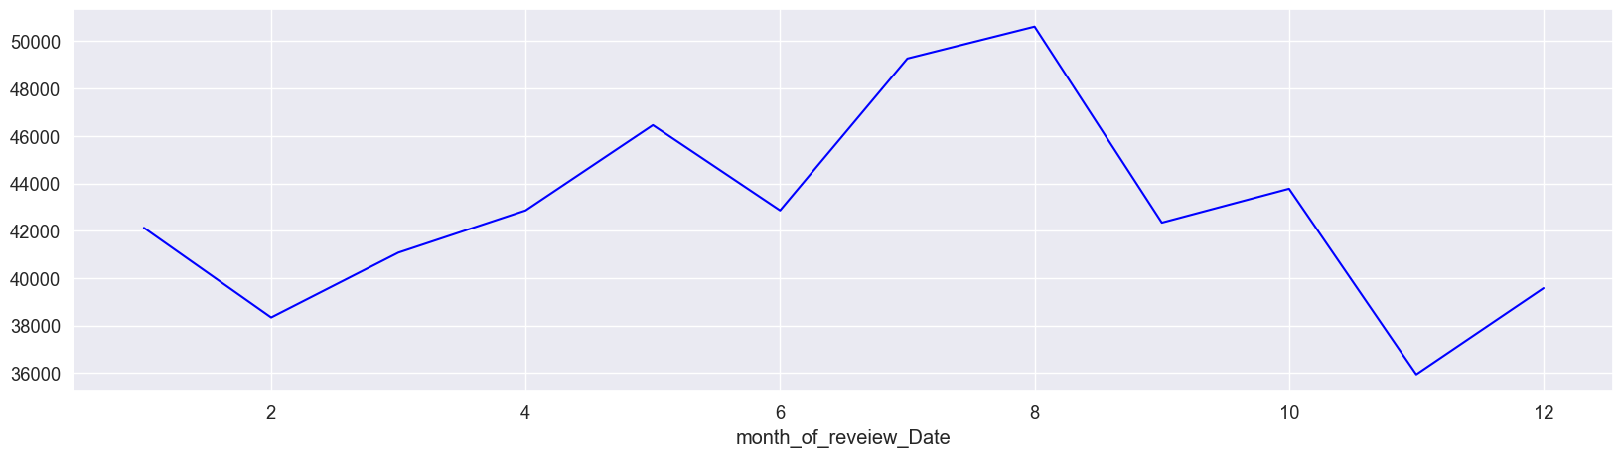
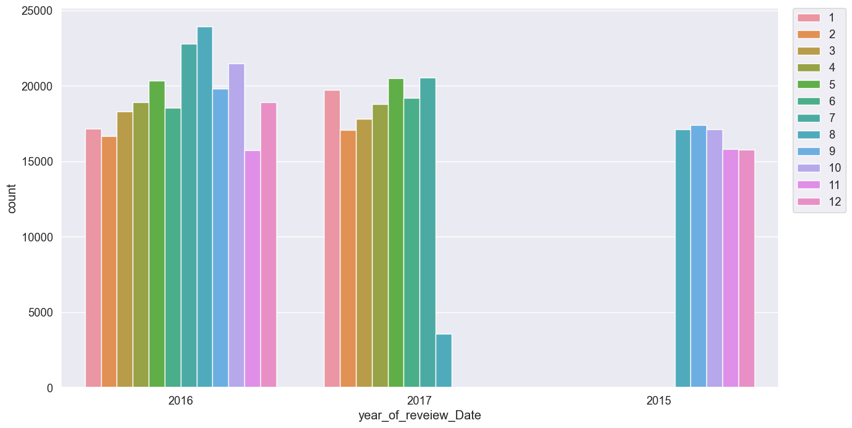
Trend Month Each Year
Most of people review in the month of August
Distribution Months each year

Slide 7
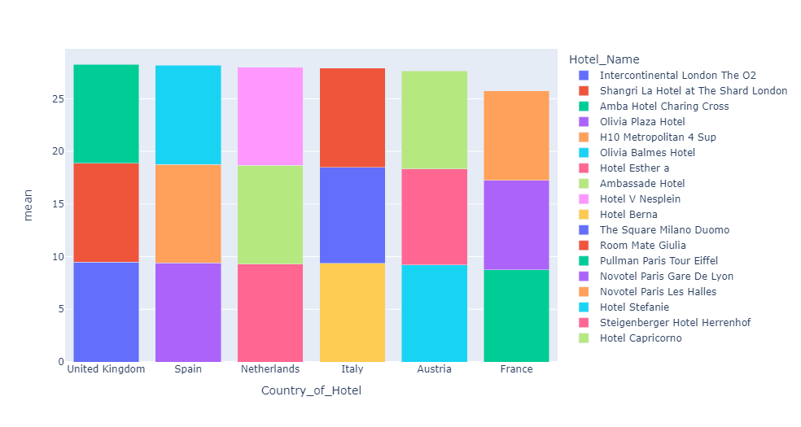
the best three hotel in each country for staying were selected based on the guests’ reviews and according to the number of guests for the same hotel in the data
Country_of_Hotel | Hotel_Name | mean | count
United Kingdom | Intercontinental London The O2 | 9.471327 | 2532
United Kingdom | Amba Hotel Charing Cross | 9.404220 | 782
Spain | Olivia Plaza Hotel | 9.395969 | 769
Spain | Olivia Balmes Hotel | 9.435375 | 506
Netherlands | Hotel Esther a | 9.310335 | 1819
Netherlands | Ambassade Hotel | 9.386885 | 549
Italy | Hotel Berna | 9.363838 | 1037
Italy | Room Mate Giulia | 9.434893 | 513
France | Pullman Paris Tour Eiffel | 8.745665 | 819
France | Novotel Paris Gare De Lyon | 8.507401 | 554
Austria | Hotel Stefanie | 9.219064 | 876
Austria | Hotel Capricorno | 9.305512 | 508

Slide 8
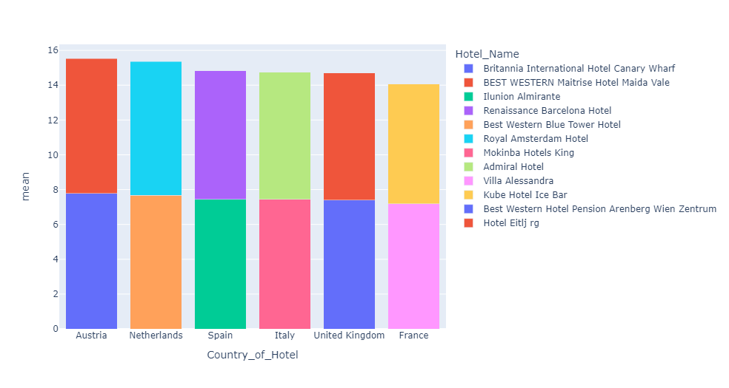
the worst two hotel in each country for staying were selected based on the guests’ reviews and according to the number of guests for the same hotel in the data
Country_of_Hotel | Hotel_Name | mean | count
United Kingdom | Britannia International Hotel Canary Wharf | 7.397394 | 4067
United Kingdom | BEST WESTERN Maitrise Hotel Maida Vale | 7.308183 | 721
Spain | Ilunion Almirante | 7.443590 | 234
Spain | Renaissance Barcelona Hotel | 7.380000 | 30
Netherlands | Best Western Blue Tower Hotel | 7.682794 | 773
Netherlands | Royal Amsterdam Hotel | 7.672078 | 154
Italy | Mokinba Hotels King | 7.437313 | 134
Italy | Admiral Hotel | 7.316000 | 25
France | Villa Alessandra | 7.196000 | 25
France | Kube Hotel Ice Bar | 6.871429 | 14
Austria | Best Western Hotel Pension Arenberg Wien Zentrum | 7.778771 | 179
Austria | Hotel Eitlj rg | 7.750000 | 12

Slide 9
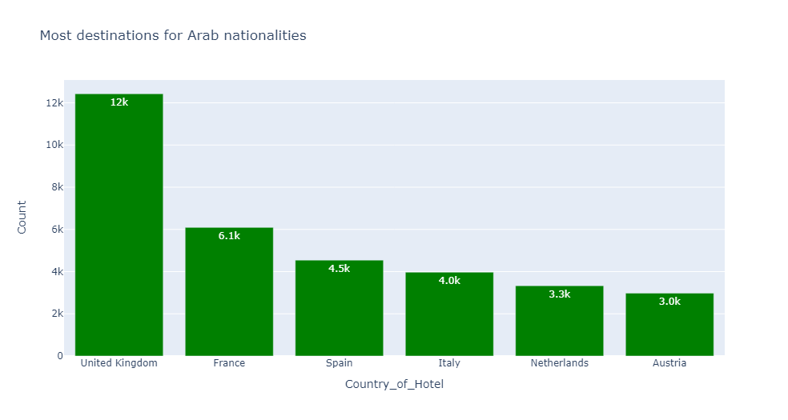
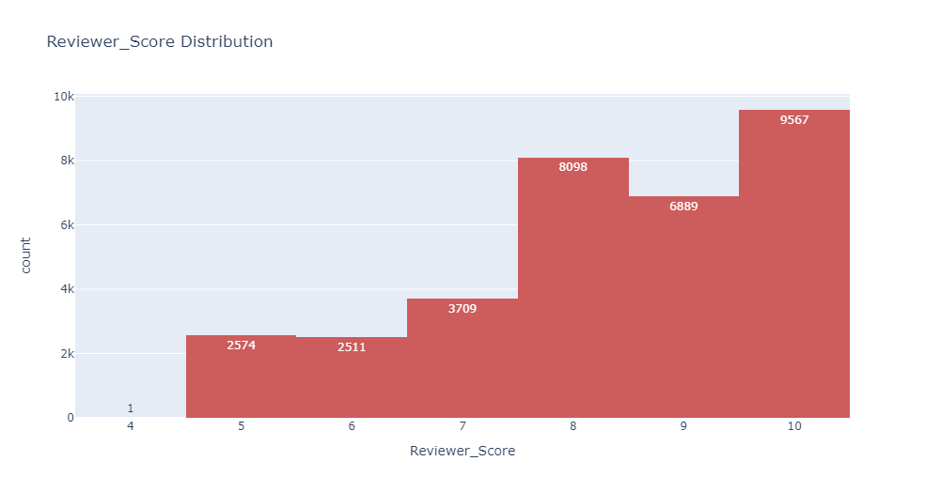
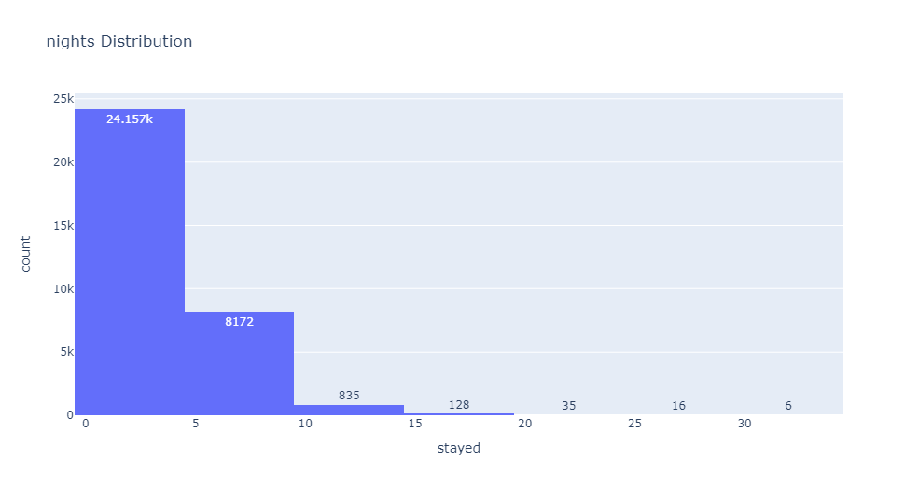
Arab Guest • As for the countries, the most destinations were the United Kingdom, then France and Spain. • Average number of nights stay 3 nights. • The rating is from 7.5 to 9.5 Emiratis are the most numerous in all countries except France, the Saudis are more.

Slide 10
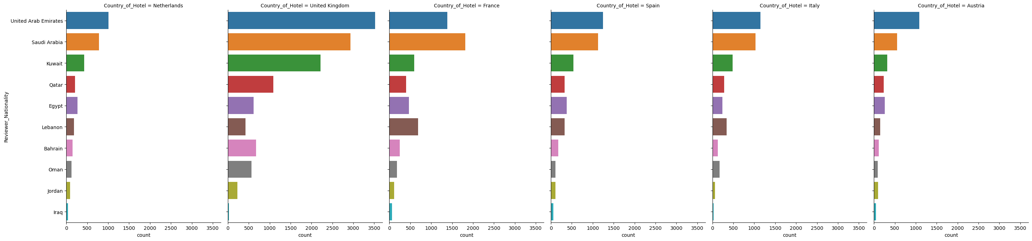
The majority of Arabs who come to any country

Slide 11
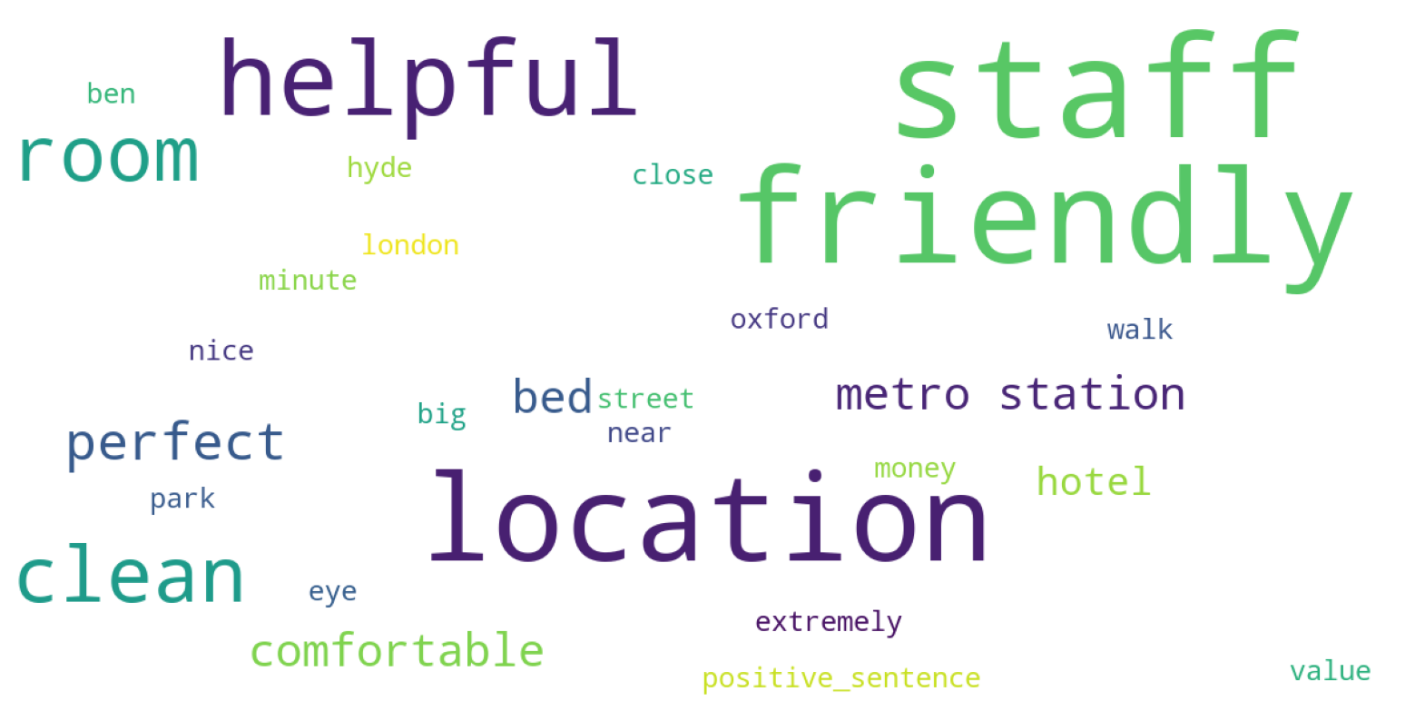
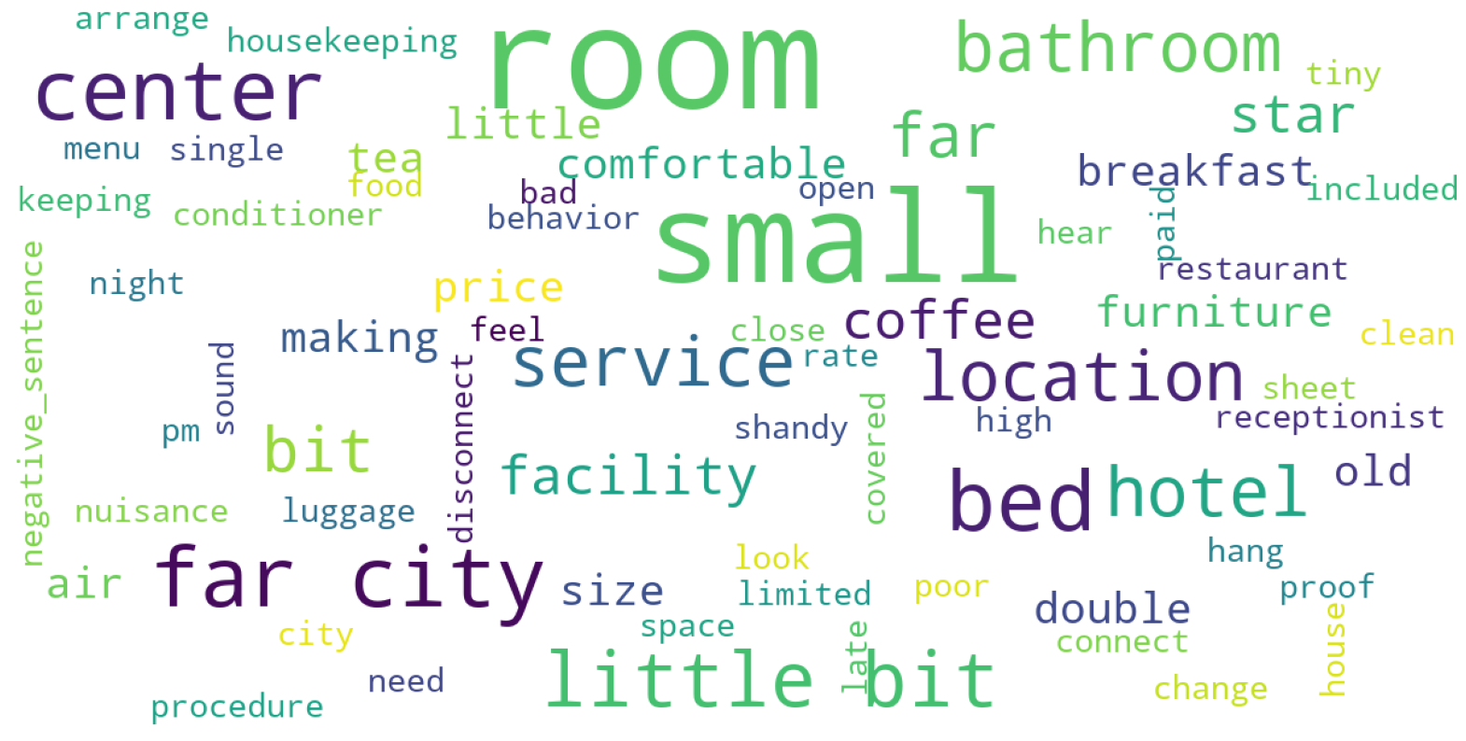
Positive Comment and Negative Comment for Arab
Positive Comment
Negative Comment

Slide 12
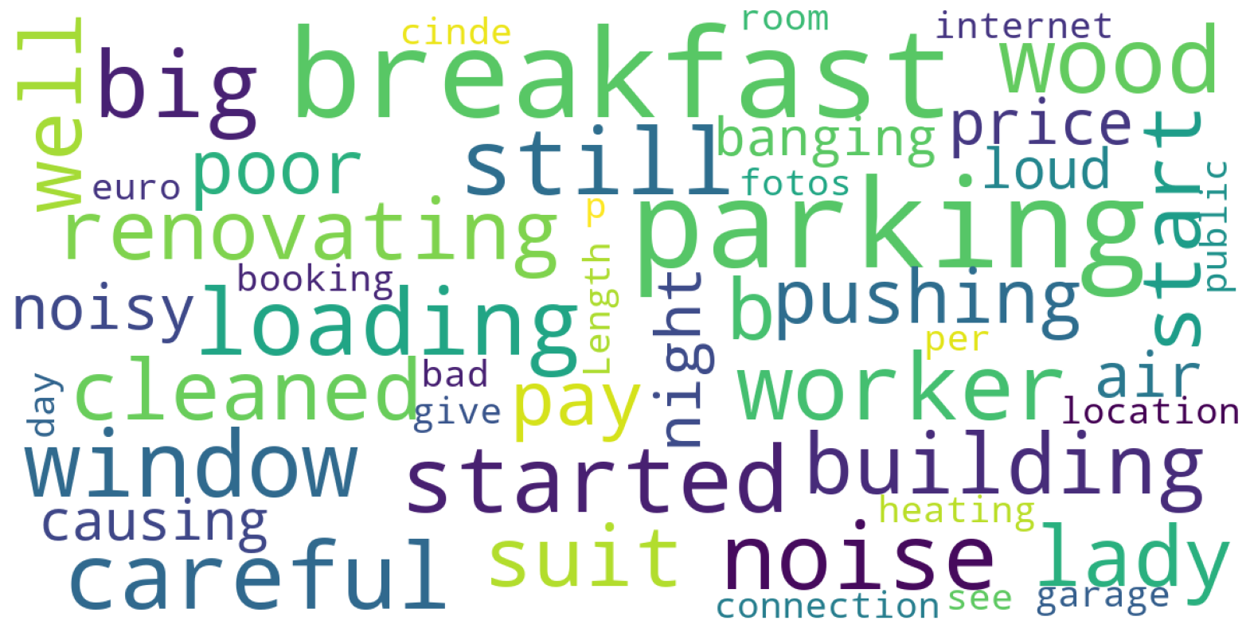
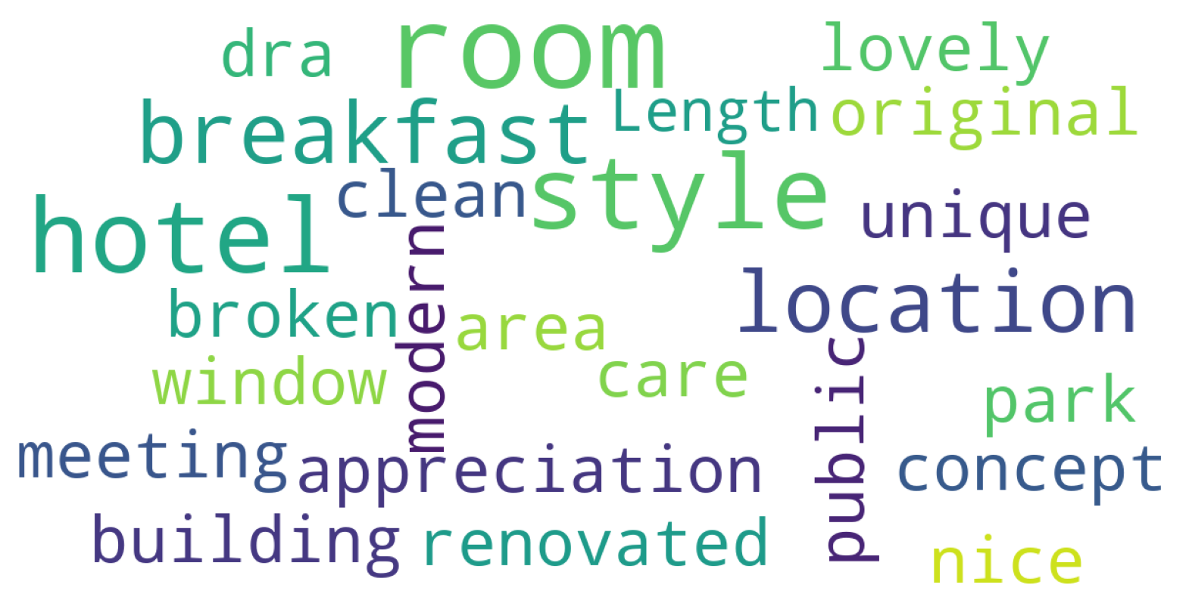
business trips
Positive Comment
Negative Comment

Slide 13
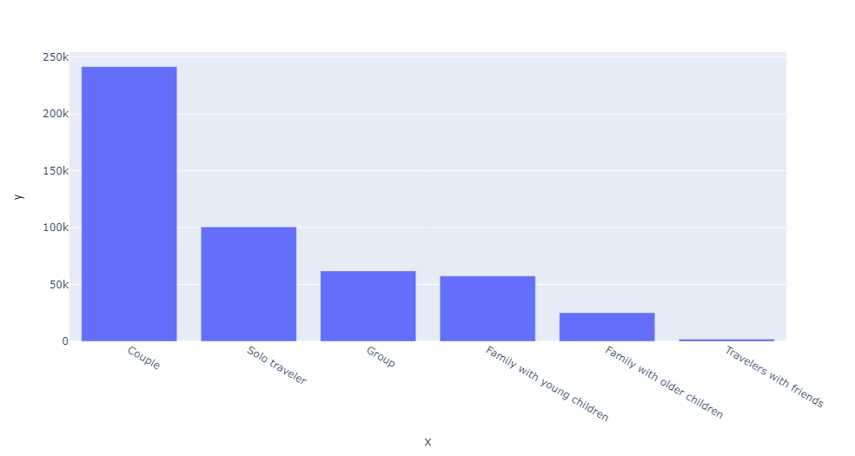
What about the type of guests, whether single or couple, what are the most important points that make them happy with the experience, and also what are the most important requests of those who have pets?
Most of the guests are couples or solo, and couples are more 50% of the data.

Slide 14
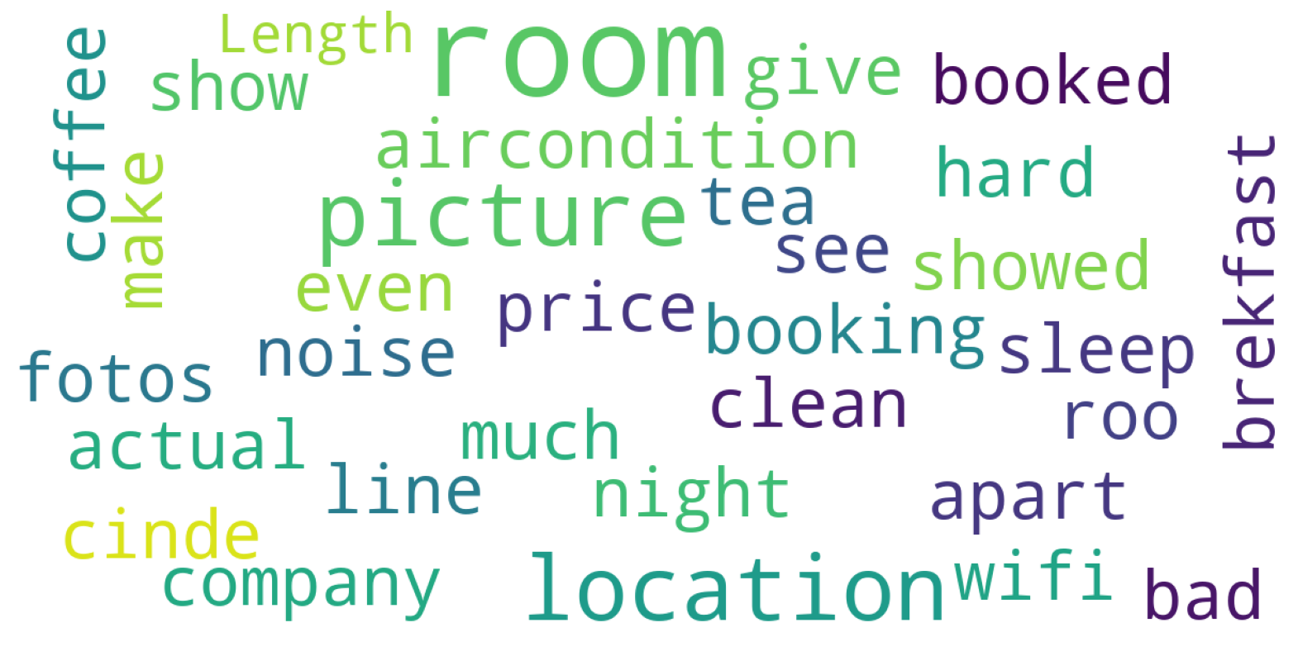
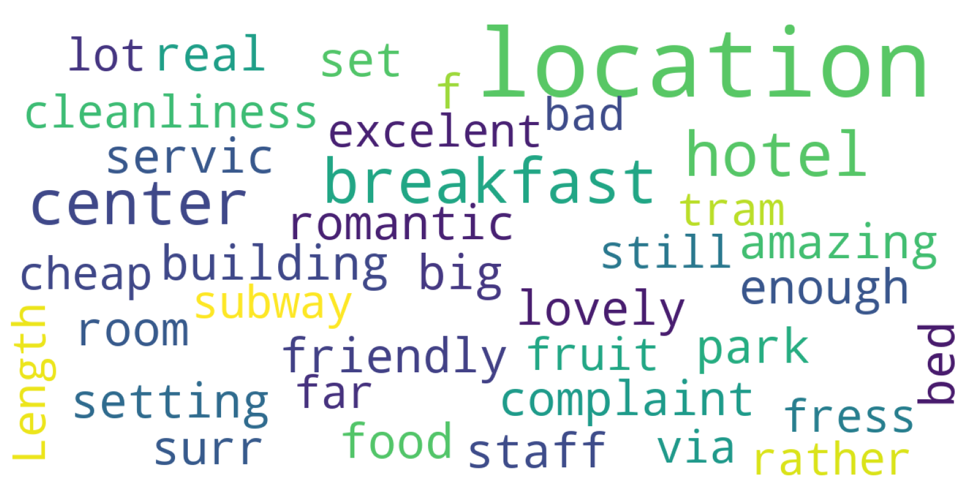
Couple • The couples were not satisfied with the breakfast, tea, and coffee services, and many of them talked about the Wi-Fi service and the rooms, and some mentioned that the pictures of the hotel were not the truth. • But the couples were satisfied with the location of the hotel, the cheap price, and the location outside the hotel, and romantic.
Negative Comment
Positive comment

Slide 15
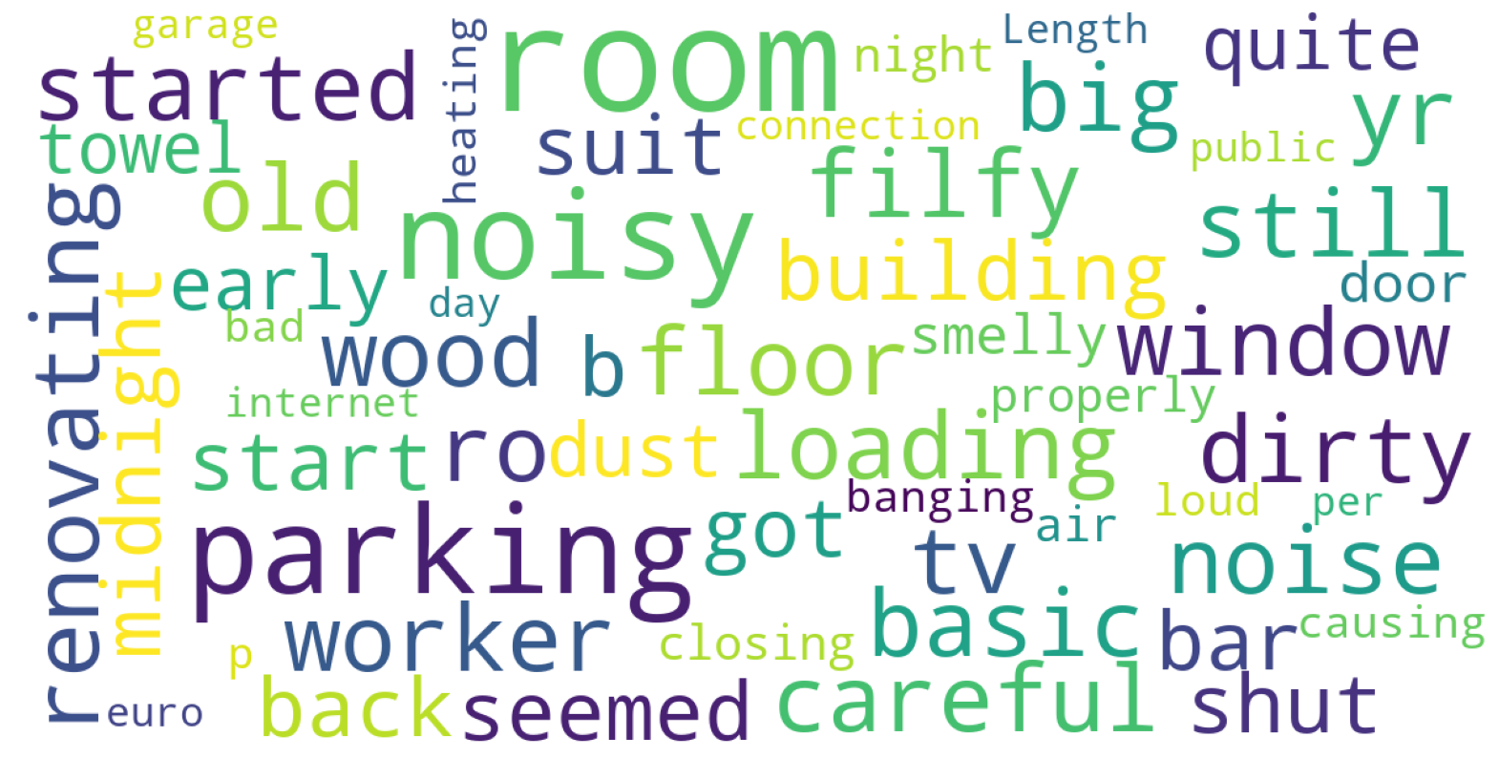
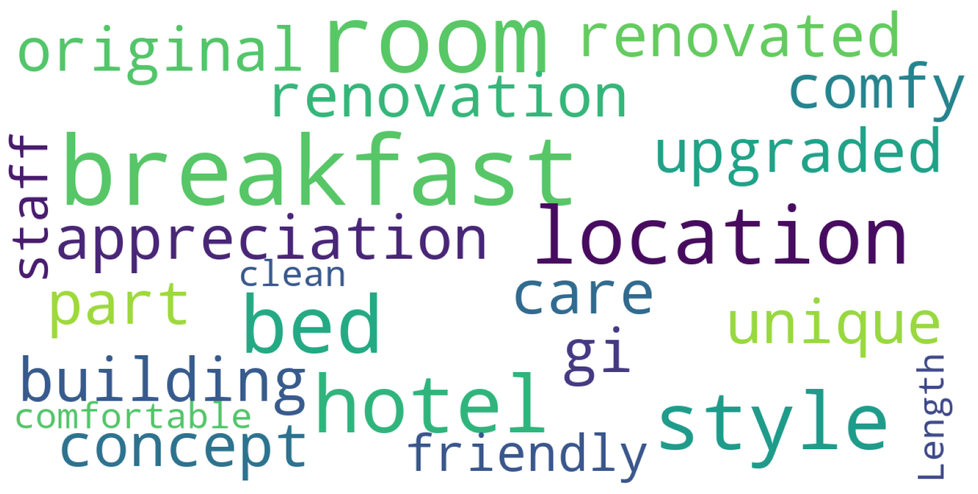
Solo Traveler • As for solo guests, the negative comments were more than positive. The negatives were noise, bad smell, uncleanliness, and parking. • As for the positive, the location was breakfast and the room.
Negative Comment
Positive comment

Slide 16
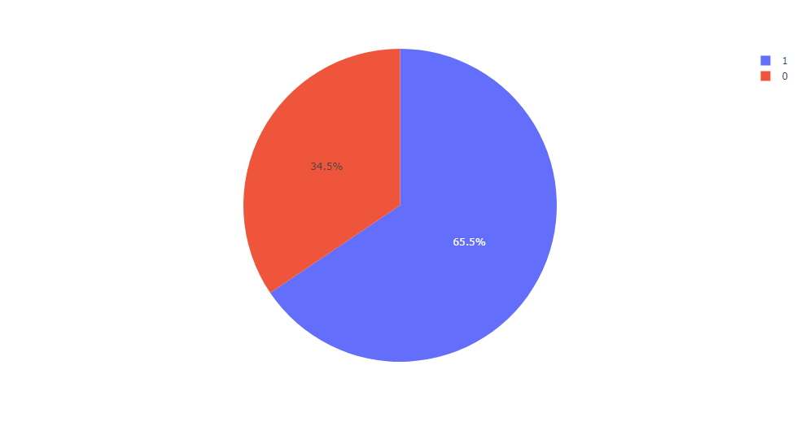
What is the ratio of tourists to non-tourists in the data
Through the tourist column, the data filtered, whereby a person who has a nationality and wrote a review of a hotel in the same country is not a tourist, and if otherwise, he is a tourist, in the data We have 35% are non-tourists and 65% are tourists.

